Slide 1

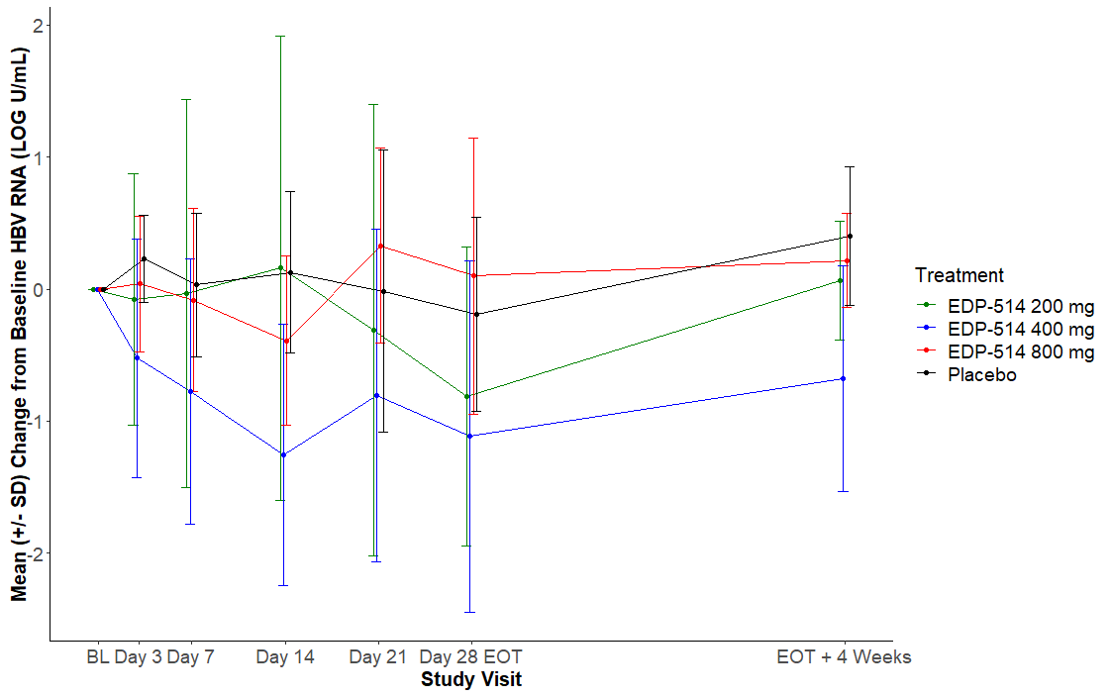
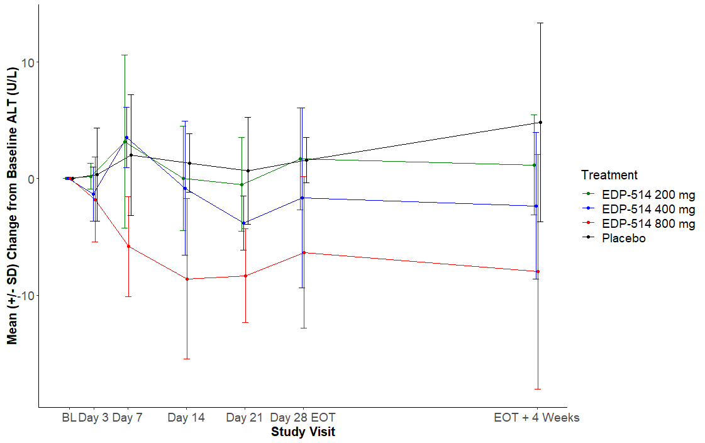
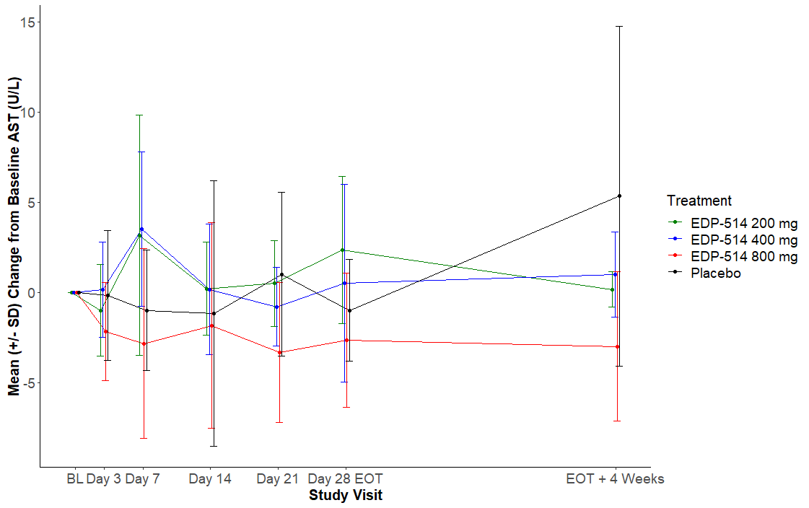
EDP-514, a Novel Pangenotypic Class II Hepatitis B Virus Core Inhibitor: Results of a 28-day Phase 1b Study in NUC-suppressed CHB Patients
Jordan J. Feld¹, Eric Lawitz², Tuan Nguyen³, Jacob Lalezari⁴, Tarek Hassanein⁵, Paul Martin⁶, Steven-Huy Han⁷, Douglas Dieterich⁸, Jeanne-Marie Giard⁹, Guy De La Rosa¹⁰, Alaa Ahmad¹⁰, Ed Luo¹⁰, Annie L. Conery¹⁰, Nathalie Adda¹⁰
¹Toronto Centre for Liver Disease, University Health Network, Toronto, Canada, ²Texas Liver Institute, San Antonio, Texas, USA, ³Tuan Nguyen MD Gastroenterology and Hepatology, San Diego, California, USA, ⁴Quest Clinical Research, San Francisco, California, USA, ⁵Southern California Research Center, Coronado, California, USA, ⁶Gastroenterology, University of Miami, Florida, USA, ⁷University of California, Los Angeles, Los Angeles, California, USA, ⁸Division of Liver Diseases, Icahn School of Medicine at Mount Sinai, New York, NY, USA, ⁹Centre Hospitalier Universitaire de Montréal, Montréal, Québec, Canada, ¹⁰Enanta Pharmaceuticals, Inc., Watertown, Massachusetts, USA
822
INTRODUCTION
RESULTS
Antiviral Activity
Chronic hepatitis B virus (HBV) infection is a global public health challenge, with estimates of more than 296 million HBV carriers worldwide, of whom approximately 820,000 die annually from HBV-related liver disease. There is an unmet medical need for curative therapy, i.e., a finite treatment which yields a sustained post-treatment response.
EDP-514 is a novel class II HBV core inhibitor. EDP-514 inhibits HBV replication with an in vitro EC₅₀ of 18, 27 and 17 nM in HepAD38, HepDE19, and HepG2.2.15 cells, respectively, and a >4-log viral load reduction in HBV-infected chimeric mice with human liver cells. EDP-514 was shown to be generally safe and well tolerated over a broad range of single and multiple doses for up to 14 days in healthy adult subjects. Here, we present results of a Phase 1b, 28-day study in non-cirrhotic, HBeAg(+) or (-) Chronic Hepatitis B (CHB) patients virologically suppressed on Nucleos(t)ide (NUC) therapy.
Subject Disposition and Demographics
Pharmacokinetics
At Day 28, mean HBV RNA change of -0.81, -1.12, 0.10, and -0.19 log U/mL were observed in the 200 mg, 400 mg, 800 mg and placebo groups, respectively (Table 4, Figure 4)
EDP-514 led to a maximum HBV RNA reduction of 2.3 log in HBeAg(-) and 2.8 log in HBeAg(+) subjects in EDP-514 arms compared to 1.2 log in placebo
For the EDP-514 800 mg subjects, 5 of 6 subjects had either non-detectable or very low levels of HBV RNA at baseline; consequently, the effect of EDP-514 on HBV RNA could not be assessed in these subjects
As expected in this NUC-suppressed patient population, there were no discernible changes in HBV DNA, and also, no changes in HBeAg, HBcrAg, and HBsAg
There were no instances of virologic failure were reported
A total of 24 subjects were enrolled in the study
One subject from the EDP-514 200 mg arm discontinued from the study due to an adverse event of upper abdominal pain
Subjects were mostly male, Asian, HBeAg(-), with a mean age of 45 years, mean HBV DNA of 1.67 IU/mL, and mean HBV RNA of 1.13 log U/mL at baseline
Subject demographics and disease characteristics are summarized in Table 1
EDP-514 exposure increased with increasing multiple doses, with time-linear pharmacokinetics (Table 2, Figure 2)
Exposures of EDP-514 increased with multiple dosing with an accumulation index of ~1.3
PK supportive of once daily dosing, with median C_{trough} at Day 28 ~16-fold for 200 mg, ~18-fold for 400 mg, and ~21-fold for 800 mg the protein-adjusted EC₅₀
Table 2. EDP-514 Day 28 Plasma PK Parameters
Table 1. Baseline Demographics and Disease Characteristics
PK Parameters | 200 mg QD (N=6) | 400 mg QD (N=6) | 800 mg QD (N=6)
AUC_{0-last} (ng/mL*hr)ª | 17498 (11.8) | 22438 (19.5) | 39331 (19.8)
C_{max} (ng/mL)ª | 3405 (11.5) | 4048 (14.9) | 7495 (21.9)
C_{trough} (ng/mL)^{b} | 1110 (860-1150) | 1245 (1080-1700) | 1465 (1100-2850)
Table 4. HBV RNA (Log U/mL) Change with 28-day Treatmentª
METHODS
 | 200 mg QD (N=6) | 400 mg QD (N=6) | 800 mg QD (N=6) | Placebo (N=6) | Overall (N=24)
Sex [n (%)]
Female | 4 (66.7) | 0 | 4 (66.7) | 1 (16.7) | 9 (37.5)
Male | 2 (33.3) | 6 (100) | 2 (33.3) | 5 (83.3) | 15 (62.5)
Race [n (%)]
White | 1 (16.7) | 1 (16.7) | 1 (16.7) | 3 (50.0) | 6 (25.0)
Black or African American | 0 | 2 (33.3) | 0 | 0 | 2 (8.3)
Asian | 5 (83.3) | 3 (50.0) | 5 (83.3) | 3 (50.0) | 16 (66.7)
Ethnicity [n (%)]
Not Hispanic or Latino | 6 (100) | 6 (100) | 6 (100) | 6 (100) | 24 (100)
Age (y)ª | 43.2 (25, 62) | 41.8 (34, 52) | 43.0 (31, 49) | 52.7 (45, 61) | 45.2 (25, 62)
BMI (kg/m²)ª | 24.46 (18.3, 31.1) | 27.22 (23.5, 34.6) | 26.81 (24.8, 31.0) | 28.09 (23.0, 34.4) | 26.64 (18.3, 34.6)
HBeAg negative [n (%)​] | 5 (83.3) | 5 (83.3) | 5 (83.3) | 6 (100) | 21 (87.5)
HBV DNA (IU/mL)^{a,b} | 2.50 (0.0, 10.0) | 2.50 (0.0, 5.0) | 1.67 (0.0, 5.0) | 0.00 (0.0, 0.0) | 1.67 (0.0, 10.0)
HBV RNA (Log U/mL)^{a,c} | 1.18 (0.0, 2.5) | 1.57 (0.0, 3.7) | 0.83 (0.0, 4.2) | 0.96 (0.0, 2.1) | 1.13 (0.0, 4.2)
HBV RNA < LOD [n (%)]^{c} | 3 (50.0) | 2 (33.3) | 5 (83.3) | 4 (66.7) | 14 (58.3)
Tenofovir (TAF/TDF) [n (%)] | 5 (83.3) | 5 (83.3) | 6 (100) | 6 (100) | 22 (91.7)
 | 200 mg QD (N=6) | 400 mg QD (N=6) | 800 mg QD (N=6) | Placebo (N=6)
Baseline | 1.18 (0.0, 2.5) | 1.57 (0.0, 3.7) | 0.83 (0.0, 4.2) | 0.96 (0.0, 2.1)
Change at Day 28 | -0.81 (-2.3, 0.0)^{b} | -1.12 (-2.8, 0.2) | 0.10 (-1.9, 0.8)* | -0.19 (-1.2, 0.8)
Study Design
Eight subjects per cohort were randomized 3:1 to receive multiple once-daily oral doses of either EDP-514 at 200, 400, and 800 mg doses or placebo for 28 days.
The first cohort received 200 mg of EDP-514 and cohort progression was determined by a Study Adjudication Committee after review of blinded safety and available PK data.
Study Design
Data presented as Mean (%CV)
Data presented as Median (Interquartile Range)
N=6, except for 200 mg AUC_{0-last}, C_{max}, N=4 and C_{trough} N=5
NUC-suppressed CHB Patients
Figure 2. Mean Plasma PK Concentrations vs. Time Following Oral Administration of EDP-514 at Day 1 and Day 28
Data presented in Mean (Range)
n = 5
*5 of 6 subjects had HBV RNA < LOD at baseline and the effect of EDP-514 on HBV RNA could not be assessed in these subjects
MAD
28 days
Figure 4. Antiviral Activity by HBV RNA Change from Baseline Over Time
EDP-514+NUC vs.
PBO+NUC
Dose 200 mg
Dose 400 mg
Dose 800 mg
Key Objectives
Primary
To evaluate the safety and tolerability of multiple doses of EDP-514 administered to NUC-suppressed CHB patients
Secondary
To evaluate the plasma PK of multiple doses of EDP-514 of NUC-suppressed CHB patients
To evaluate the antiviral activity of multiple doses of EDP-514 in NUC-suppressed CHB patients
a. Presented as Mean (Min, Max), b. HBV DNA Limit of Detection = 10 IU/mL, c. HBV RNA Limit of Detection = 1.65 Log U/mL
BMI = Body Mass Index; QD = Once Daily, y = Year, TAF = tenofovir alafenamide, TDF = tenofovir disoproxil fumarate
Safety
Key Inclusion/Exclusion Criteria
Inclusion Criteria:
Male and female subjects of any ethnic origin between the ages of 18 and 70 years
CHB subjects must have HBsAg detectable at screening and in most recent test at least 6 months prior
Screening HBV DNA < LLOQ and no HBV DNA ≥ LLOQ over previous 12 months
No change in HBV NUC treatment regimen for 12 months prior to screening
Exclusion Criteria:
Documented prior diagnosis of cirrhosis
Documented extensive bridging fibrosis or cirrhosis
Evidence of hepatocellular carcinoma by imaging or screening AFP ≥ 50 ng/mL
Meeting defined safety laboratory parameters at screening
Coinfection with HIV, HAV, HCV, HDV, or HEV
Chronic liver disease of non-HBV etiology
Overall, EDP-514 was generally safe and well-tolerated in 200, 400 and 800 mg doses (Table 3)
Eight patients reported treatment emergent adverse events (TEAEs); all were mild except for 1 moderate event (upper abdominal pain) in the EDP-514 200 mg arm that led to study drug discontinuation, and 1 severe event (drug hypersensitivity [allergic reaction to aloe cream]) in the EDP-514 800 mg arm that was unrelated to study drug
There were no Grade 4 or serious TEAEs
There were no clinically significant laboratory abnormalities, including no clinically significant ALT/AST elevations or notable differences in mean (+/- SD) change from baseline of all arms (Figure 3), and no clinically meaningful changes in ECG or vital signs
CONCLUSIONS
EDP-514 was generally safe and well-tolerated at 200, 400 and 800 mg doses for 28 days in NUC-suppressed CHB patients
EDP-514 was rapidly absorbed and EDP-514 exposure increased with increasing multiple doses
EDP-514 exhibited PK suitable for once daily oral dosing, with Ctrough concentrations reaching up to ~20-fold above the paEC₅₀
At Day 28, EDP-514 demonstrated reductions in circulating HBV RNA levels, consistent with its mechanism of action as an HBV core inhibitor
Table 3: Summary of TEAEs Following Administration of EDP-514 in the MAD Phase
Figure 3: ALT and AST Mean (+/- SD) from Baseline Over Time
System Organ Class Preferred Term [n (%)] | 200 mg QD (N=6) | 400 mg QD (N=6) | 800 mg QD (N=6) | Placebo (N=6) | Overall (N=24)
Total Subjects with at Least One TEAE | 5 (83.3) | 1 (16.7) | 2 (33.3) | 0 | 8 (33.3)
Gastrointestinal disorders
Nausea | 1 (16.7)* | 1 (16.7) | 0 | 0 | 2 (8.3)
Abdominal pain upper | 1 (16.7)* | 0 | 0 | 0 | 1 (4.2)
Diarrhoea | 1 (16.7)* | 0 | 0 | 0 | 1 (4.2)
Investigations
Blood creatine phosphokinase increased | 0 | 0 | 2 (33.3)^ | 0 | 2 (8.3)
Neutrophil count decreased | 0 | 0 | 1 (16.7)^ | 0 | 1 (4.2)
White blood cell count decreased | 0 | 0 | 1 (16.7)^ | 0 | 1 (4.2)
Nervous system disorders
Dizziness | 1 (16.7) | 0 | 0 | 0 | 1 (4.2)
Headache | 0 | 1 (16.7) | 0 | 0 | 1 (4.2)
Respiratory, thoracic and mediastinal disorders
Hyperventilation | 1 (16.7) | 0 | 0 | 0 | 1 (4.2)
Rhinorrhoea | 1 (16.7) | 0 | 0 | 0 | 1 (4.2)
General disorders and administration site conditions
Fatigue | 1 (16.7) | 0 | 0 | 0 | 1 (4.2)
Immune system disorders
Drug hypersensitivity | 0 | 0 | 1 (16.7) | 0 | 1 (4.2)
Infections and infestations
Urinary tract infection | 1 (16.7) | 0 | 0 | 0 | 1 (4.2)
Skin and subcutaneous tissue disorders
Pruritus | 1 (16.7) | 0 | 0 | 0 | 1 (4.2)
Vascular disorders
Flushing | 1 (16.7)* | 0 | 0 | 0 | 1 (4.2)
n = Number of Subjects *Occurred in same subject, ^Occurred in same subject
ALT
Assessments
Safety and tolerability assessments
Adverse events, clinical laboratory tests, physical examinations, vital signs, and electrocardiograms
PK assessments
On Days 1 and 28, blood samples were collected at predose and at 0.5, 1, 2, 3, 4, 5, 6 and 8 hours postdose
On Days 3, 7, 14 and 21, blood samples were collected at predose, 1-3 hrs postdose and at least 1 hr after the first postdose sample and prior to next dose
Concentrations of EDP-514 and its metabolites were measured using a validated method
PK parameters were determined using non-compartmental methods in Phoenix WinNonlin (Pharsight Corporation)
Antiviral activity assessments
HBV DNA levels
Incidences of virologic failure defined as HBV DNA level ≥LLOQ and which is confirmed to be ≥LLOQ on repeat testing
REFERENCES
EDP-514, a novel HBV core inhibitor with potent antiviral activity both in vitro and in vivo. M Vaine, et al. J Hepatology, VOLUME 70, ISSUE 1, SUPPLEMENT, E474-E475
EDP-514, a novel pangenotypic class II hepatitis B virus core inhibitor: preliminary results of a phase 1 study in healthy adult subjects. K Larson, et al. J Hepatology, VOLUME 73, SUPPLEMENT 1, S871
AST
ACKNOWLEDGEMENT
Special thanks to Yan Zhang (Enanta) for assistance with QC
We extend our thanks to the subjects who participated in this study and the PRA team for their involvement in the study
DISCLOSURES
GDLR, AA, EL, ALC and NA are employees of Enanta Pharmaceuticals, Inc. and may be stockholders
AASLD The Liver Meeting 12-15 November 2021 © 2021 Enanta Pharmaceuticals, Inc.

