Slide 1

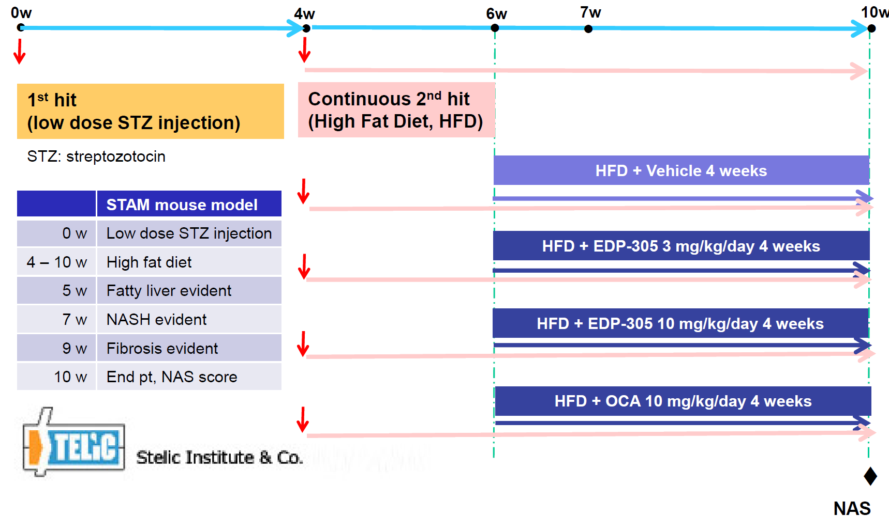
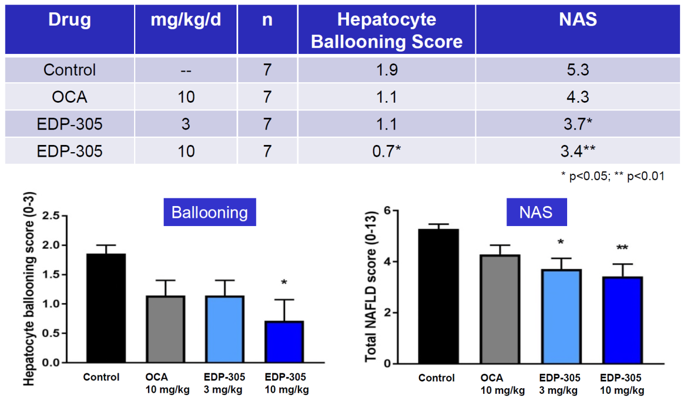
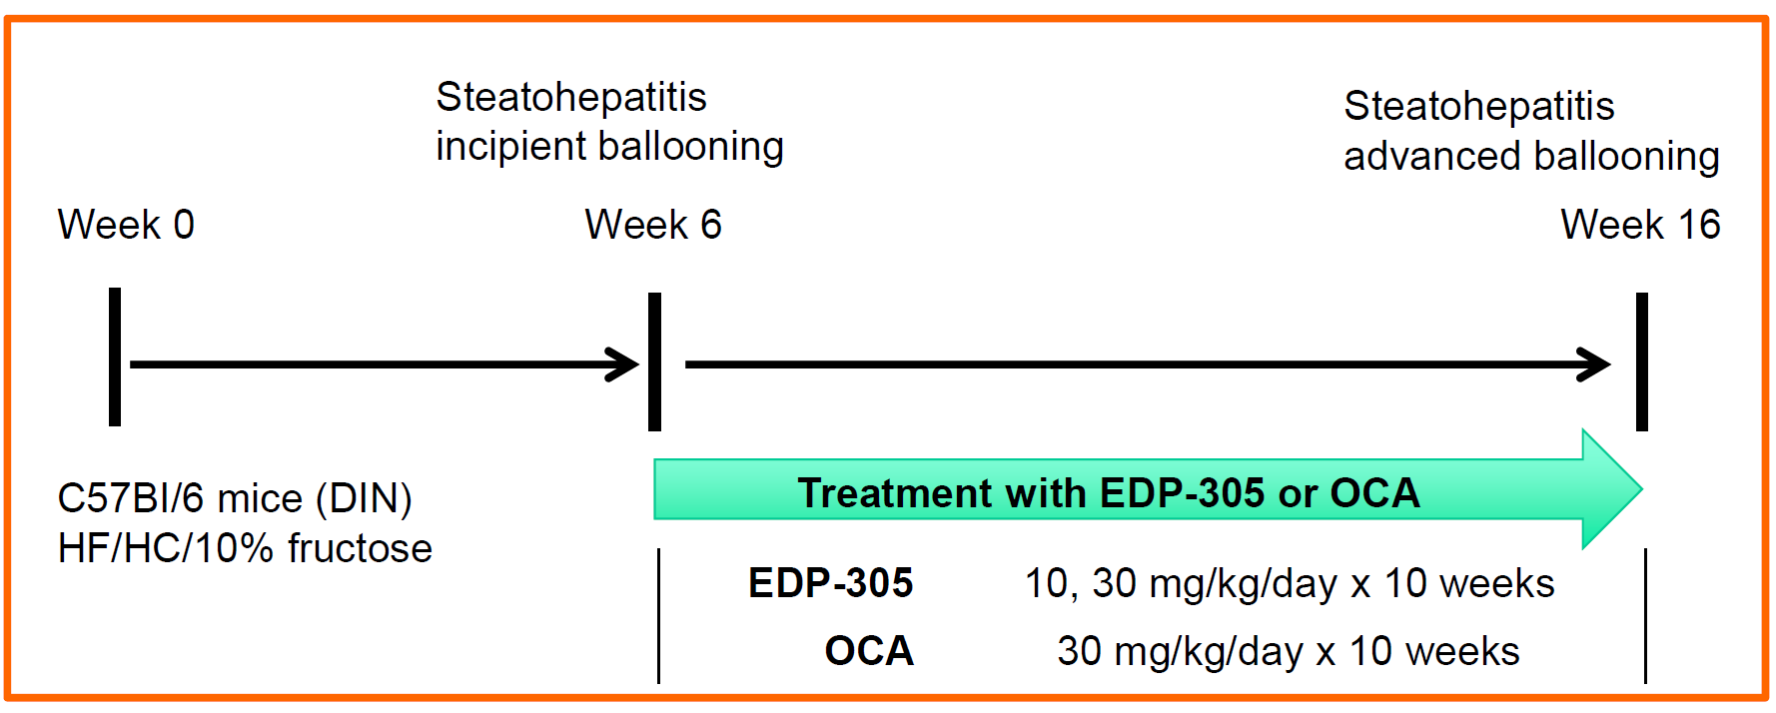
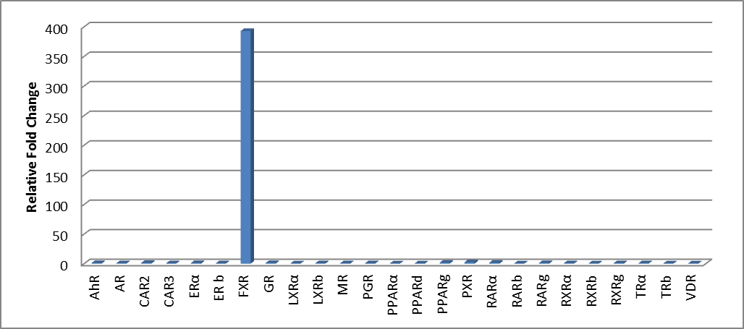
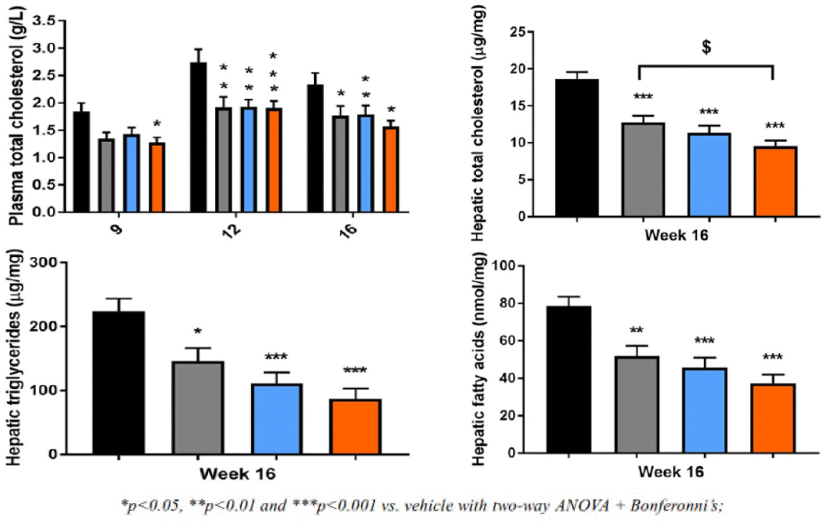
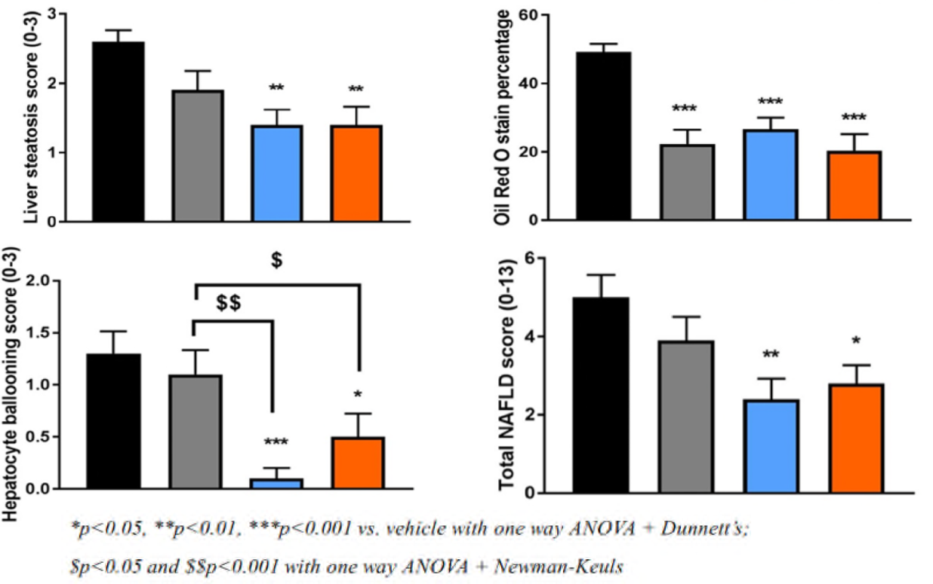
EDP-305, a highly selective and potent FXR agonist, reduces liver steatosis, ballooning, and non-alcoholic fatty liver disease activity score(NAS) in two murine models of NASH Li-Juan Jiang, Mary Chau, Yang Li & Yat Sun Or Enanta Pharmaceuticals, Inc. Watertown, MA, USA
To request a pdf of this poster,
email ljiang@enanta.com
Background
Methods
STAMTM mouse model
EDP-305, a selective and potent small molecule FXR agonist, is currently in clinical development for the treatment of non-alcoholic steatohepatitis (NASH) and primary biliary cholangitis (PBC). EDP-305 regulates the expression of key genes in the bile acid metabolism, lipid metabolism, inflammation, fibrosis and glucose metabolism. Herein we report the therapeutic efficacy of EDP-305 in two murine models of NASH: Diet Induced NASH (DIN) model and STAMTM model.
In the DIN model, NASH was induced in C57Bl/6 mice with a high fat, high cholesterol diet plus 10% fructose in drinking water. All treatments were administered between 6 weeks (steatohepatitis with incipient ballooning) and 16 weeks (advanced steatohepatitis with advanced ballooning). Treatments included: EDP-305 (10 or 30 mg/kg), or vehicle control (n=10/group). In the STAMTM model, NASH was induced in C57Bl/6 by a single subcutaneous injection of 200 µg streptozotocin 2 days after birth, followed by feeding with a high fat diet starting at 4 weeks of age. All treatments were administered between 4 weeks and 10 weeks. Treatments included: EDP-305 (3 or 10 mg/kg), or vehicle control (n=8/group). Liver injury, progression of NASH, liver steatosis, and ballooning were evaluated by serum chemistry and histology.
EDP-305 is a potent and selective FXR agonist
Compound | FXR (HEK) | TGR5 (CHO)
 | EC50 nM (% efficacy)*
Obeticholic Acid (OCA) Glyco-OCA Tauro-OCA | 130 (150) 360 (155) 250 (100) | 380 ( 72) 720 (157) 540 (161)
EDP-305 | 8 (152) | > 15,000 (NS)
CHO Cells
CDCA
Efficacy (%)
OCA
Results
EDP-305
Diet-induced NASH (DIN) Mouse Model
* Transporter inserted, FXR efficacy CDCA = 100%; TGR5 efficacy LCA = 100%
Compound concentration (µM)
EDP-305 is Highly Selective for FXR
In the STAMTM model, EDP-305 significantly reduced hepatocyte ballooning scores as well as total NAS.
EDP-305 regulates key gene expression In vitro
Bile acid metabolism
SHP; FGF19; OST-α; BSEP; CYP7A1
Lipid metabolism
LDLR; PCSK9;SREBP-1C; SCD1; CD36; DGAT2; APOB; APOC3; HL; SRB1
Inflammation
NF-κB; TLR2; TLR9; TNFα; IL8; IL1α; IL1β; IL1R1; CCL2; CCR1; CCR4; CEBPB
Fibrosis
α-SMA; TIMP1; TIMP2; PDGFα; PDGFβ; COL1A2; COL3A1; ITGB6
Glucose metabolism
FGF21; IRS2; GLUT2; GLUT4; FOXO1
Conclusions
 | Up regulation
 | Down regulation
Fig 1. EDP-305 reduces plasma and liver lipid content in the DIN mouse. A. Plasma total cholesterol levels in DIN mice treated with vehicle, EDP-305 10 mg/kg, EDP-305 30 mg/kg, and OCA 30 mg/kg. Hepatic total cholesterol (B), triglycerides (C), and fatty acid (D) levels in DIN mice.
Fig 2. EDP-305 improves hepatocyte ballooning and NAS. NAFLD scoring: steatosis (A), hepatocyte ballooning (C), total score (D), and Oil Red O staining (B) in DIN mice treated with vehicle, EDP-305 10 mg/kg, EDP-305 30 mg/kg, and OCA 30 mg/kg.
Treatment with EDP-305 had a significant therapeutic effect on NASH progression in NASH mouse models, resulting in decreased liver steatosis, hepatocyte ballooning, and total NAS. These results warrant further investigation of EDP-305 as a potential therapy for NASH.
In the DIN model, EDP-305 significantly reduced hepatic cholesterol, triglycerides, and fatty acids by 48.4%, 61.1% and 52.5%, respectively, versus vehicle control.
Consistent with the observed reductions in liver lipids, liver steatosis was significantly decreased in EDP-305-treated mice (p<0.01).
EDP-305 significantly reduced total NAS in both treatment groups, consistent with decreased expression of key genes involved in inflammation (MCP-1 and TGF-β) and fibrosis (TIMP-1 and α-SMA).
EDP-305 significantly decreased liver steatosis, hepatocyte ballooning, and total NAS in diet-induced NAS (DIN) mice model.
Acknowledgements
We thank Drs. Guoqiang Wang and Ruichao Shen for synthesizing the compounds, and appreciate Taishi Hashiguchi and Yuichiro Shibazaki from Stelic, Japan; François Briand and Thierry Sulpice from Physiogenex, France gave advice during these studies.
References
Lefebvre & Friedman, et al., POLS One (2016)
Friedman, et al., AASLD presentation (2005)
Digestive Disease Week (DDW), June 2-5, 2018, Washington, D. C., USA © 2018 Enanta Pharmaceuticals, Inc.

